Slide 1
Calendar Management
[stock image]
Logo
Practice
Notes:
Screen Title: Title Updated on: 8/31/2021
Slide #: 1 of _
Interactions: none
Navigation: next to Menu slide
Animation: title appears
Transcript:

Slide 2
Menu
[A description of what each button allows the learner to do will appear here when they roll over the button]
Review
Guided Practice
Independent Practice
Notes:
Screen Title: Menu Updated on: 8/31/2021
Slide #: 2 of _
Interactions: 3 buttons – each will take learner on a different branched path; click, rollover
Navigation: 3-way branch
Animation: buttons appear ; description of what each option is for appears when learners rollover the button
Transcript:

Slide 3


Instructions
[A sample question will be here]
[Screen shot or simplified mock-up of what a practice problem will look like;
Features highlighted as verbal instructions mention them]
Skip
Instructions
Notes:
Screen Title: Independent Practice Instructions Updated on: 9/1/2021
Slide #: 3 of _
Interactions:
button showing and hiding written instructions
“Skip” button > to Scenario 1
Navigation:
“Menu” button > menu screen
Next > a randomly selected scenario from Level 1
Animation:
boxes, arrows or other guidance appears as mentioned during instruction
each instructional step has rollover that displays any associated guidance on the mock-up to the right
Transcript:

Slide 4
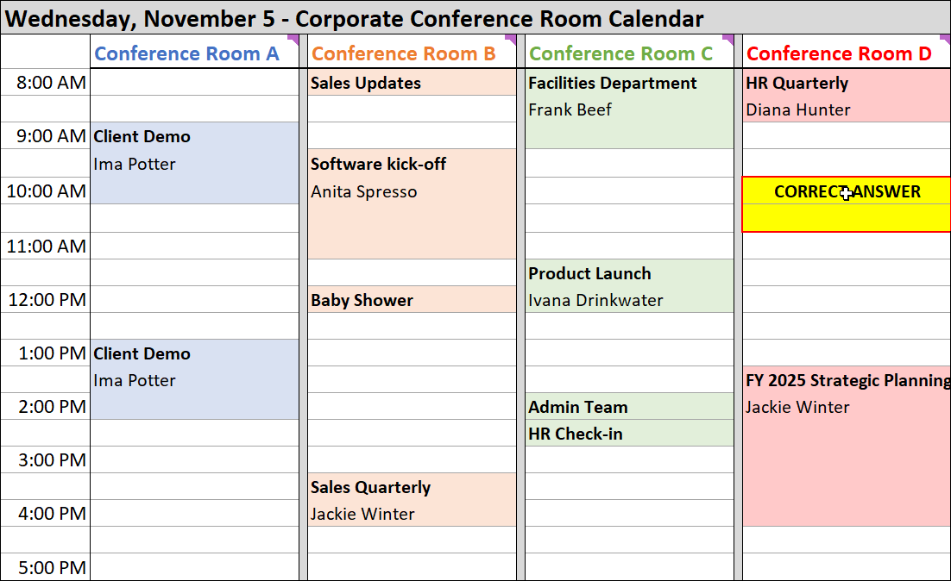
Scenario 1 of 6
Conference Room Calendar
Tom’s Calendar
Using the information below, schedule a conference room for Tom’s presentation.
Tom needs a projector and teleconference speakers
There will be 25 people, but 5 are calling in on the speakers
Tom’s office is 15 minutes away from the building with the conference rooms
The meeting will take 1 hour
Notes:
Screen Title: Practice Scenario 1 of 6 Updated on: 9/29/2021
Slide #: 4 of _
Notes:
all of the practice scenario screens will be set up the same way
There will be 18 scenarios (6 levels of difficulty; 3 scenarios at each level)
Learners will do 6 scenarios: 1 randomized scenario from each level, in order from the simplest to the most complex
I have only depicted 2 screens here because they will look the same but for the actual scenario
Interactions: not sure what the mechanics for solving the problem will look like yet
Navigation:
Correct > advance to a randomly selected scenario from level 2
Incorrect > a randomly selected scenario from level 1 (not the one just answered)
Animation: none
Transcript: Tom Morrow needs to present findings from a company financial analysis to upper management on Wednesday. He’s asked you to schedule it for him.

Slide 5
Scenario 1 of 6
Conference Room Calendar
Tom’s Calendar
Using the information below, schedule a conference room for Tom’s presentation.
Tom needs a projector and teleconference speakers
There will be 25 people, but 5 are calling in on the speakers
Tom’s office is 15 minutes away from the building with the conference rooms
The meeting will take 1 hour
Notes:
Screen Title: Practice Scenario 1 of 6 Updated on: 9/29/2021
Slide #: 4 of _
Notes:
all of the practice scenario screens will be set up the same way
There will be 18 scenarios (6 levels of difficulty; 3 scenarios at each level)
Learners will do 6 scenarios: 1 randomized scenario from each level, in order from the simplest to the most complex
I have only depicted 2 screens here because they will look the same but for the actual scenario
Interactions: not sure what the mechanics for solving the problem will look like yet
Navigation:
Correct > advance to a randomly selected scenario from level 2
Incorrect > a randomly selected scenario from level 1 (not the one just answered)
Animation: none
Transcript: Tom Morrow needs to present findings from a company financial analysis to upper management on Wednesday. He’s asked you to schedule it for him.

Slide 6
Scenario 1 of 6
New Meeting
Conference Room Calendar
Tom’s Calendar
Title
[autofills]
Using the information below, schedule a conference room for Tom’s presentation.
Tom needs a projector and teleconference speakers
There will be 25 people, but 5 are calling in on the speakers
Tom’s office is 15 minutes away from the building with the conference rooms
The meeting will take 1 hour
Start Time
[autofills date when not relevant]
[dropdown for time selection]
End Time
[autofills date when not relevant]
[dropdown for time selection]
Required Attendees
[dropdown with select multiple enabled]
Optional Attendees
[dropdown with select multiple enabled]
Location
[dropdown with select multiple enabled]
High Priority?
Submit
Notes:
Screen Title: Practice Scenario 1 of 6 Updated on: 9/29/2021
Slide #: 4 of _
Notes:
all of the practice scenario screens will be set up the same way
There will be 18 scenarios (6 levels of difficulty; 3 scenarios at each level)
Learners will do 6 scenarios: 1 randomized scenario from each level, in order from the simplest to the most complex
I have only depicted 2 screens here because they will look the same but for the actual scenario
Interactions: not sure what the mechanics for solving the problem will look like yet
Navigation:
Correct > advance to a randomly selected scenario from level 2
Incorrect > a randomly selected scenario from level 1 (not the one just answered)
Animation: none
Transcript: Tom Morrow needs to present findings from a company financial analysis to upper management on Wednesday. He’s asked you to schedule it for him.

Slide 7
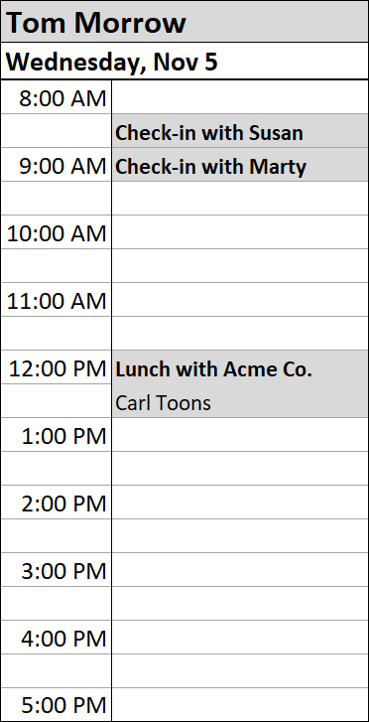
Scenario 1 of 6
Conference Room Calendar
Tom’s Calendar
Using the information below, schedule a conference room for Tom’s presentation.
Tom needs a projector and teleconference speakers
There will be 25 people, but 5 are calling in on the speakers
Tom’s office is 15 minutes away from the building with the conference rooms
The meeting will take 1 hour
Notes:
Screen Title: Practice Scenario 1 of 6 Updated on: 9/1/2021
Slide #: 4 of _
Notes:
all of the practice scenario screens will be set up the same way
There will be 18 scenarios (6 levels of difficulty; 3 scenarios at each level)
Learners will do 6 scenarios: 1 randomized scenario from each level, in order from the simplest to the most complex
I have only depicted 2 screens here because they will look the same but for the actual scenario
Interactions: I’m not sure how learners will answer the question yet
Navigation:
Correct > advance to a randomly selected scenario from level 2
Incorrect > a randomly selected scenario from level 1 (not the one just answered)
Animation: none
Transcript:

Slide 8

Scenario 1 of 6
[Corrective feedback will be given in an overlaid box for both correct and incorrect answers.
Feedback will be somewhat intrinsic with character from scenario giving the feedback.]
Continue
Try Another
Notes:
Screen Title: Practice Scenario 2 of 6 Updated on: 9/2/2021
Slide #: 5 of _
Notes:
This is another copy of the practice scenario screen but showing how corrective feedback will be given.
Corrective feedback will be show for correct and incorrect answers but will be different for each
The character giving the feedback will change based on who is featured in each practice scenario – characters giving the feedback make it somewhat intrinsic, so learners can see the human effects of inappropriately scheduling appointments
Interactions:
not sure what the mechanics for solving the problem will look like yet
“Continue” button
“Try Another” button
Navigation:
Correct >“Continue” > advance to a randomly selected scenario from level 3
Incorrect > “Try Another” > a randomly selected scenario from level 2 (not the one just answered)
Animation: none
Transcript:

Slide 9
Scenario 1 of 6
[Corrective feedback about time chosen…
Corrective feedback about location chosen…
Corrective feedback about attendees]
Continue
Try Another
Notes:
Screen Title: Practice Scenario 2 of 6 Updated on: 9/2/2021
Slide #: 5 of _
Notes:
This is another copy of the practice scenario screen but showing how corrective feedback will be given.
Corrective feedback will be show for correct and incorrect answers but will be different for each
The character giving the feedback will change based on who is featured in each practice scenario – characters giving the feedback make it somewhat intrinsic, so learners can see the human effects of inappropriately scheduling appointments
Interactions:
not sure what the mechanics for solving the problem will look like yet
“Continue” button
“Try Another” button
Navigation:
Correct >“Continue” > advance to a randomly selected scenario from level 3
Incorrect > “Try Another” > a randomly selected scenario from level 2 (not the one just answered)
Animation: none
Transcript:

Slide 10
Scenario 2 of 6
Conference Room Calendar
Tom’s Calendar
[The question and any information needed to answer it will be here]
Notes:
Screen Title: Practice Scenario 3 of 6 Updated on: 9/1/2021
Slide #: 6 of _
Notes:
I’m experimenting with how the scenario will be displayed and how learners will “answer” the question
all of the practice scenario screens will be set up the same way
There will be 18 scenarios (6 levels of difficulty; 3 scenarios at each level)
Learners will do 6 scenarios: 1 randomized scenario from each level, in order from the simplest to the most complex
I have only depicted 2 screens here because they will look the same but for the actual scenario
Interactions: not sure what the mechanics for solving the problem will look like yet
Navigation:
Correct > advance to a randomly selected scenario from level 2
Incorrect > a randomly selected scenario from level 1 (not the one just answered)
Animation: none
Transcript:

Slide 11
Scenario 2 of 6
Conference Room Calendar
Tom’s Calendar
Notes:
Screen Title: Practice Scenario 3 of 6 Updated on: 9/1/2021
Slide #: 6 of _
Notes:
I’m experimenting with how the scenario will be displayed and how learners will “answer” the question
all of the practice scenario screens will be set up the same way
There will be 18 scenarios (6 levels of difficulty; 3 scenarios at each level)
Learners will do 6 scenarios: 1 randomized scenario from each level, in order from the simplest to the most complex
I have only depicted 2 screens here because they will look the same but for the actual scenario
Interactions: not sure what the mechanics for solving the problem will look like yet
Navigation:
Correct > advance to a randomly selected scenario from level 2
Incorrect > a randomly selected scenario from level 1 (not the one just answered)
Animation: none
Transcript:

Slide 12
Independent Practice Complete
Congratulations! What would you like to do now?
Menu
Exit
Notes:
Screen Title: Practice Complete Updated on: 8/31/2021
Slide #: 22 of _
Interactions: Buttons – click, rollover
Navigation: Exit button; menu button
Animation: buttons appear
Transcript:

Slide 13







Review:
Effective Scheduling Criteria
Working Hours
Who’s Required?
Appropriate Length
Prioritize
Location, Space & Equipment
Individual Preferences
Time Cushions
Notes:
Screen Title: Effective Scheduling Criteria Updated on: 8/31/2021
Slide #: 23 of _
Notes: These are the criteria Linnea and I discussed on 8/10 for what learners need to be able to consider or accommodate when scheduling an appointment appropriately
Interactions: buttons for each criterion – audio with brief description of each concept
Navigation: Menu button in the corner; next should also take them back to the menu
Animation: buttons appear one at a time
Transcript:

Slide 14

Guided Problem Solving
[Instructions]
[This is where the problem/scenario will be displayed with any highlighting or annotations used for guidance]
Skip
Notes:
Screen Title: Guided Problem Solving (instructions for learners) Updated on: 8/31/2021
Slide #: 24 of _
Interactions: buttons:
Right arrow > display next step
Left arrow > display previous step
Circling arrows > repeat display of current step
“Skip” > to Guided Problem 1
Navigation: Menu button to exit Guided Problem Solving sequence; next to Guided Problem 1
Animation: boxes, arrows, etc. will appear for each step to highlight any relevant areas of the problem
Transcript:

Slide 15
Guided Problem 1 of 3
[this space will display instructions for guidance for solving the problem;
only one step will appear at a time
[This is where the problem/scenario will be displayed with any highlighting or annotations used for guidance]
Notes:
Screen Title: Guided Problem 1 of 3 Updated on: 8/31/2021
Slide #: 25 of _
Interactions: buttons:
Right arrow > display next step
Left arrow > display previous step
Circling arrows > repeat display of current step
Navigation: Menu button to exit Guided Problem Solving sequence; next to Guided Problem 2
Animation: boxes, arrows, etc. will appear for each step to highlight any relevant areas of the problem
Transcript:

Slide 16
Guided Problem 2 of 3
[this space will display instructions for guidance for solving the problem;
only one step will appear at a time
Notes:
Screen Title: Guided Problem 1 of 3 Updated on: 9/1/2021
Slide #: 26 of _
Notes: I’m experimenting with the layout of the scenario and how learners will “answer” the question
Interactions: buttons:
Right arrow > display next step
Left arrow > display previous step
Circling arrows > repeat display of current step
Navigation: Menu button to exit Guided Problem Solving sequence; next to Guided Problem 3
Animation: boxes, arrows, etc. will appear for each step to highlight any relevant areas of the problem
Transcript:

Slide 17
Guided Problem Solving Complete
What would you like to do now?
Menu
Exit
Notes:
Screen Title: Guided Problem Solving Complete Updated on: 8/31/2021
Slide #: 28 of _
Interactions: Buttons – click
Navigation: Exit button; menu button
Animation: buttons appear
Transcript:

